Slide 1


WebApp for Covid-19 Cases Prediction using Prophet
Kaza Venkata Sai Madhav Email ID: kaza2v@cmich.edu

Slide 2
Overview
- Introduction
- Methods
- Results
- Conclusion

Slide 3

Hypothesis Statement of Research
“ Future 2 Year period of COVID-19 Cases Prediction when no external factors affect on the cases predicted ”
“ The cases predicted are based on time-series forecasting by using prophet algorithm for purely random numbers corresponding to dates in increasing order ”

Slide 4

Introduction
COVID – 19 and effects on world:
1) COVID-19 is an abbreviation for Coronavirus started on March 1, 2020, in Michigan State of US.
2) Coronavirus originated from a city named Wuhan, China in September 2019.
3) As of April 2021, there are 136 million cases out of which 2.94 million are deaths across the world (according to Wikipedia).

Slide 5
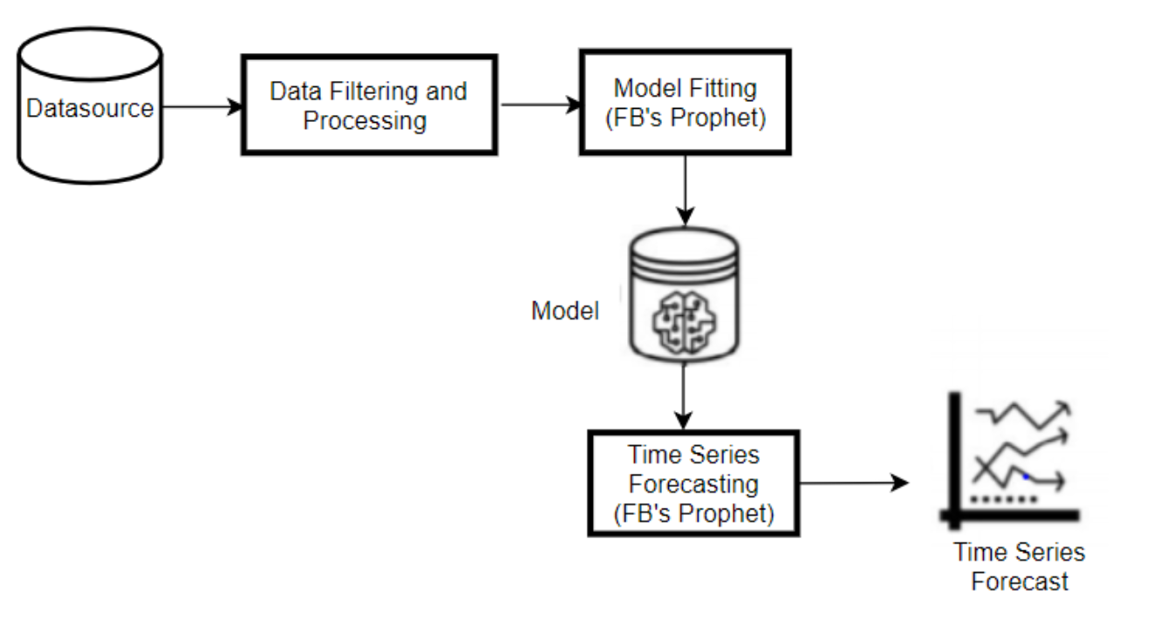

Prophet Algorithm
Prophet and it’s uses:
Prophet algorithm is designed by Facebook in the year 2017.
Prophet is an open-source tool designed by the team at Facebook for the use of Time Series Forecasting methodologies.
In the research conducted at Central Michigan University, the prophet algorithm showed promising values of 95%+ accuracy for 80% test split data.

Slide 6

Methods

Slide 7


Dual Approach to address Research Problem
Machine Learning - Usage of Prophet, Prophet Variation and Accuracy results for Prophet.
Web Application – Usage of Django, Pickle and Simulation Files and UI Interface.

Slide 8

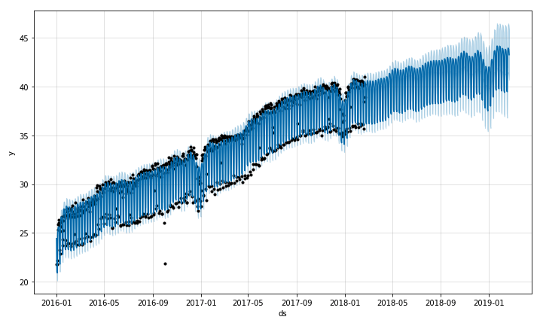
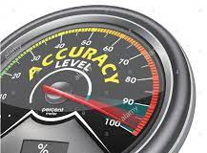
Machine Learning
1) Usage of Prophet – Time Series forecasting models can be build on 2-Year Window and can be increased to more years if we are agreeing to increased mean errors rates.
2) Prophet Variation – Prophet without Saturation and with Saturation are dual types of prophet algorithm used in the research problem.
3) Accuracy Results of Prophet –
Prophet without Saturation: Highest Accuracy is 93.52% with 35% test split and Lowest Accuracy is 0% for various test split.
Prophet with Saturation: Maximum Accuracy is 100% for more than 84% test split and Minimum Accuracy is 39.87% with 5% test split.

Slide 9
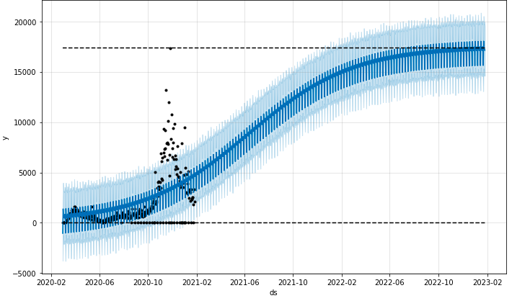
Prophet With Saturation:

Slide 10
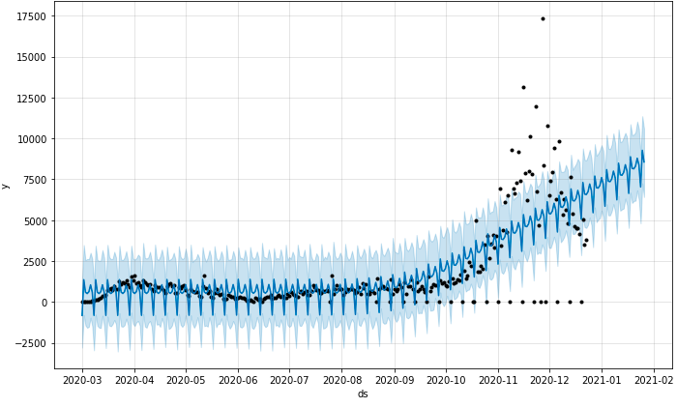
Prophet Without Saturation:

Slide 11

Web Application
Django Tool – Dynamic CRUD interface (Create, Read, Update and Delete) and Open-Source framework.
Pickle and Simulation Files – Pickling is serialization in python and simulation files are processed files after certain operations done on Downloaded Dataset.
UI Interface – HTML, CSS are used for building the UI.

Slide 12


Results

Slide 13

Accuracy

Slide 14
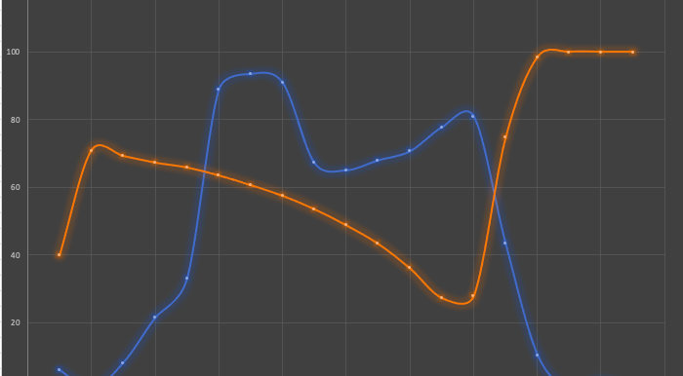

Slide 15
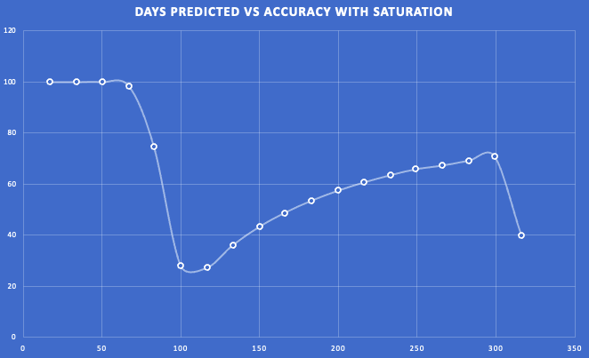

Slide 16


Web Application

Slide 17

Web Application Results for Date in 2-Year Period

Slide 18
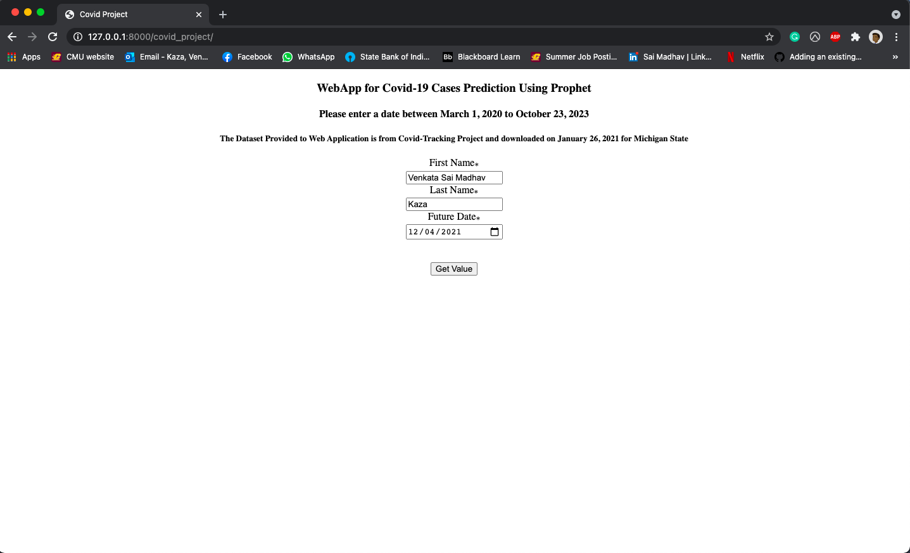
Initial Page

Slide 19
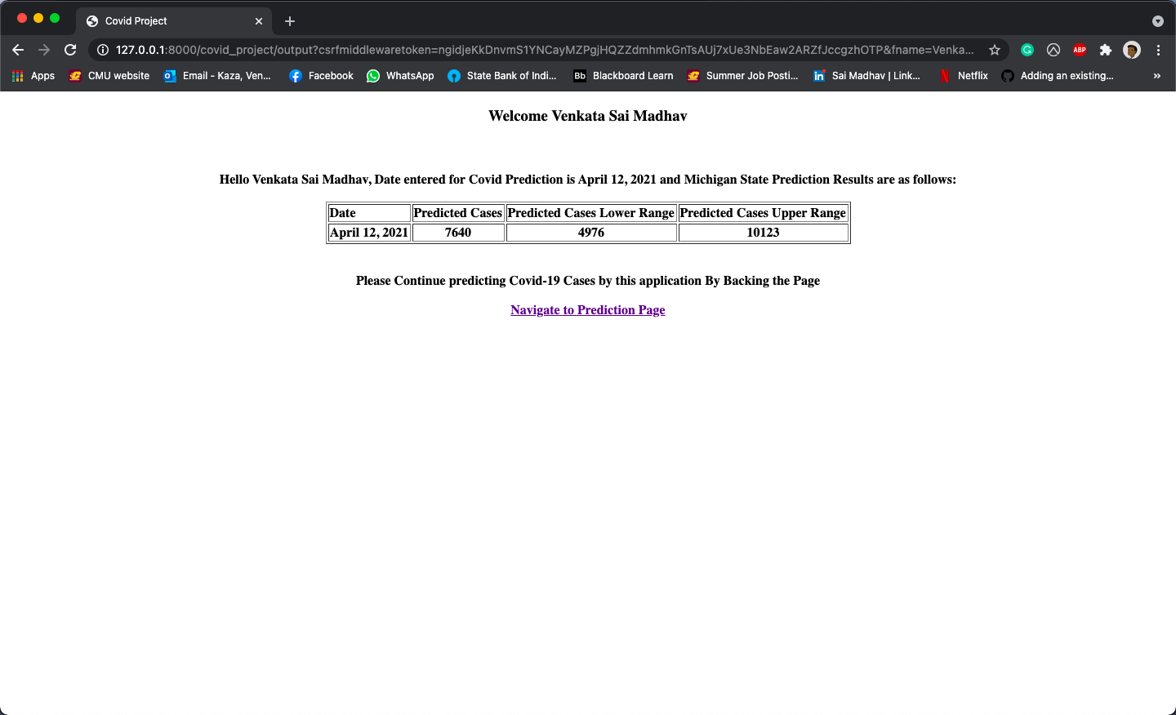
Final Page

Slide 20

Web Application Results for Date after 2-Year period

Slide 21

Initial Page

Slide 22
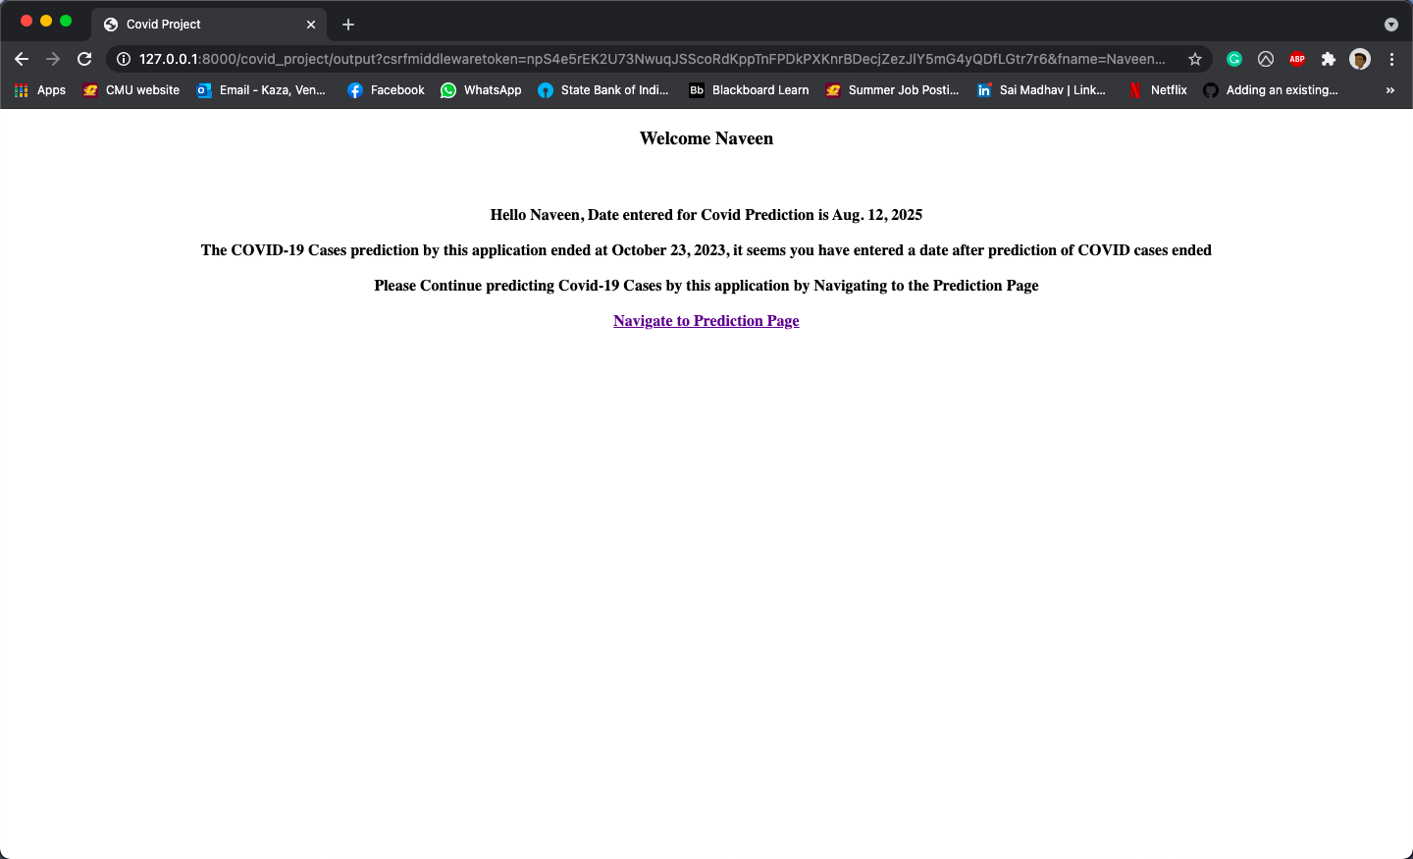
Final Page

Slide 23

Conclusion

Slide 24

To Conclude and Future work
In results, Prophet Algorithm showed promising values on the accuracy. Thus, Prophet can be used for time series forecasting of random values.
Future work gets related to web-scarping and extracting the data from the covid-tracking project daily and updating the database in the form of csv file. Thus, it is interesting to work on the project as an extension to the current on-going research.

Slide 25
Any Questions

Slide 26


Thank You Dr. Lisa Gandy Dr. Patrick Kinnicutt

